Slide 1


Amazon Sales Data Analysis:-

Slide 2
Introduction
It contains information about Amazon company's sales data over the Some past years. We've gathered data on things like sales revenue, product types, customer demographics, and order details.
Our Goal in analyzing this data is to uncover insights that can help us make smarter business decisions. We want to understand things like which products are selling best, which regions or countries are bringing in the most revenue, and how we can improve our overall profitability and efficiency.
By diving into this data, we hope to find opportunities for growth, better understand our customers' needs, and ultimately drive success for our business.

Slide 3
Details of Data:
Here We have Amazon Sales Data and all about information Which is provide us to all Related information of Selling of products and their Items Type, Quantity ,Price and Profits According to Region and related Country.
Data Overview:
Region.
Country.
Items Type.
Sales Channel.
Order Priority.
Unit Sale.
Unit Price.
Unit Cost.
Total Cost
Total Revenue.
Total Profit.
Order Date.

Slide 4
All Related Analysis:
Top Performing Regions and Countries: Identify regions and countries with the highest total revenue and profit to focus on for further business expansion and marketing efforts.
Best Selling Item Types: Determine which item types generate the most revenue and profit. This information can guide inventory management and marketing strategies.
Sales Channel Analysis: Compare the performance of sales channels (online vs. offline) to determine which channel is more effective in generating revenue and profit. Allocate resources accordingly.
Order Priority Impact: Evaluate the impact of order priority on sales and profitability. Determine if there's a correlation between order priority and revenue/profit.
Seasonal Trends: Analyze order dates and identify seasonal trends in sales. Adjust marketing and inventory strategies accordingly to capitalize on seasonal demand fluctuations.
Unit Price vs. Unit Cost Analysis: Calculate the profit margin for each item type to assess the profitability of products. Consider adjusting pricing or sourcing strategies for higher margins.
Shipping Efficiency: Analyze ship dates and identify any delays in order fulfillment. Improving shipping efficiency can lead to higher customer satisfaction and potentially increased sales.
Customer Segmentation: Segment customers based on geography, order size, or item type preferences. Target specific customer segments with tailored marketing campaigns to maximize conversion rates.

Slide 5
Analytical Dashboard:

Slide 6
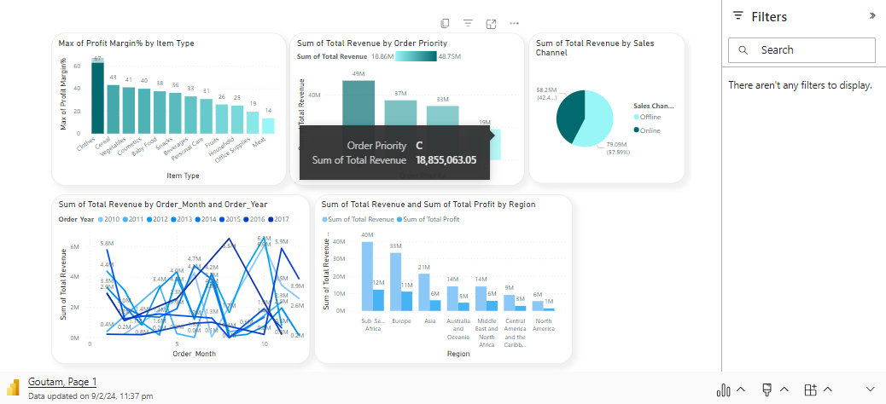
Power Bi Analysis:

Slide 7
Conclusion:
In Geographical Sub-Saharan Africa emerges as the most lucrative region, contributing significantly to both total revenue and profit. Countries like Angola, Burkina Faso, and Rwanda stand out as top performers within this region.
1
The analysis indicates that certain product types, such as Office Supplies and Baby Food, drive substantial revenue and profit. Focusing on these high-performing product categories can be beneficial for maximizing profitability.
2
In Sales Channels Analysis While both online and offline channels are utilized, further exploration is needed to understand which channel is more effective in generating revenue and profit. Optimizing strategies for the preferred channel can enhance overall performance.
3
Order priority seems to have a discernible effect on revenue and profit, suggesting that prioritizing certain orders could lead to higher profitability. Further investigation into the factors influencing order priority decisions is warranted.
4
Despite the strong performance in certain regions and product categories, there is still potential for growth. Exploring new markets, diversifying product offerings, and optimizing sales channels and order management processes can further enhance profitability.
5

Slide 8
Thank you

